Slide 1
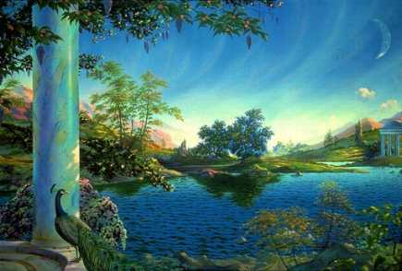
Based on this image, what do you think a ‘utopia’ might be?

Slide 2
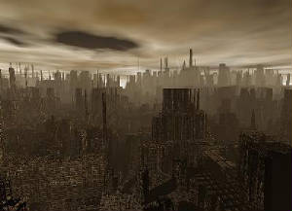
Based on this image, what do you think a ‘dystopia’ might be?

Slide 3
L.O.
Explore the conventions of dystopian fiction.
Can you remember what a ‘convention’ is?

Slide 4
L.O.
Explore the conventions of dystopian fiction.
S.C. - Can you:
identify the features of dystopian worlds?
explain what dystopian society is like?
describe a typical dystopian protagonist?

Slide 5
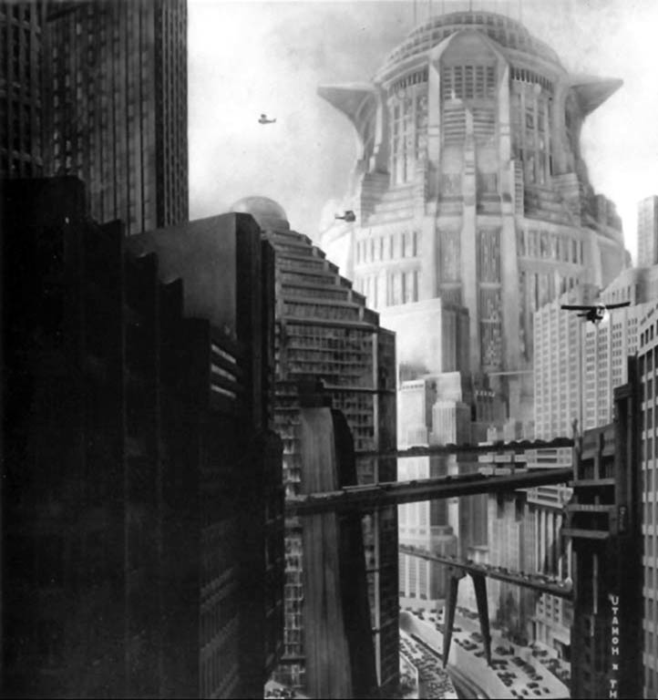
We are going to watch some trailers for dystopian films.
Whilst you are watching, make some notes on what you think the key conventions of dystopian fiction are.
Characters
Settings
Dystopian Fiction
Society
Technology

Slide 6
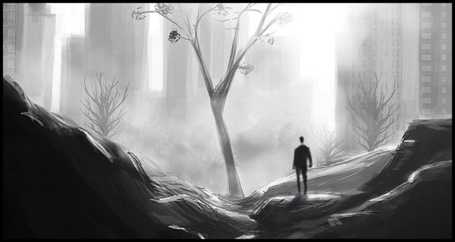
Now, read through the plot summaries of the dystopian novels in your groups.
Can you add any more to your mindmaps about dystopian fiction?

Slide 7
What are the key conventions of Dystopian Fiction?
Your challenge is to use the information you have gathered to write a summary of the key conventions of the genre – in no more than 100 words.

Slide 8
Characteristics of a Dystopian Society
• Propaganda is used to control the citizens of society.
• Information, independent thought and freedom are restricted.
• A leader/concept is worshipped by the citizens of the society.
• Citizens are perceived to be under constant surveillance.
• Citizens have a fear of the outside world.
• Citizens live in a dehumanized state.
• The natural world is banished and distrusted.
• Citizens conform to uniform expectations. Individuality and dissent are bad.
• The society is an illusion of a perfect utopian world.
The Dystopian Protagonist
• often feels trapped and is struggling to escape.
• questions the existing social and political systems.
• believes or feels that something is terribly wrong with the society in which he or she lives.
How many of these key points did you manage to cover?

